Slide 1
Paxos protocol
Rui hu
Dept. of Electrical and Computer Engineering
Univ. of Texas at San Antonio
rui.hu@my.utsa.edu

Slide 2
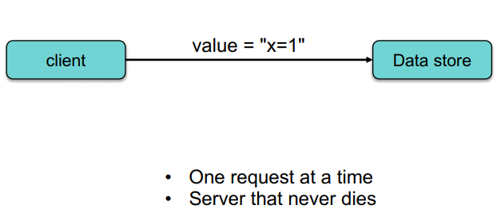
The story
One server: send request → get feedback
What if server is down?

Slide 3
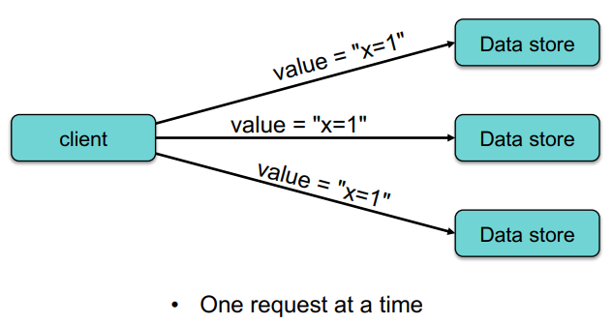
The story
Add replicas: send request to the main server → get feedback
What if the main server is down ?

Slide 4
The story
Add replicas: send request to the main server → get feedback
If the main server is down → use replicas to continue → Liveness (system is working all the time)
How to make sure replicas store the same data with the main server → Safety (data consistency / consensus)

Slide 5
The story – Paxos as a solution
Assume: If every node starts from the same state, then after executing the same commands, every node ends up at the same state. (Replication State Machine)
Paxos: Guarantee that the proposals/commands under one proposal/command index are the same. → every node ends at the same state as long as they start from the same state. → How to achieve?

Slide 6
The story – Paxos as a solution
Our goal: let the N-th proposal execute command x on every node;
Action: Send request <N, x> to every node;
Result: If a majority of the nodes agree, then every node executes the command x;

Slide 7
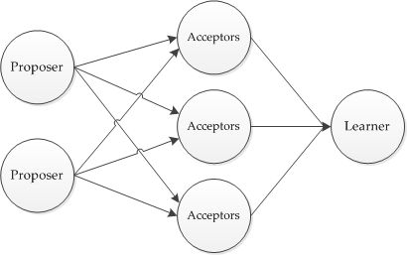
Action of Paxos
Each node/client can be a:
Proposer
Acceptor
Learner
at the same time.

Slide 8
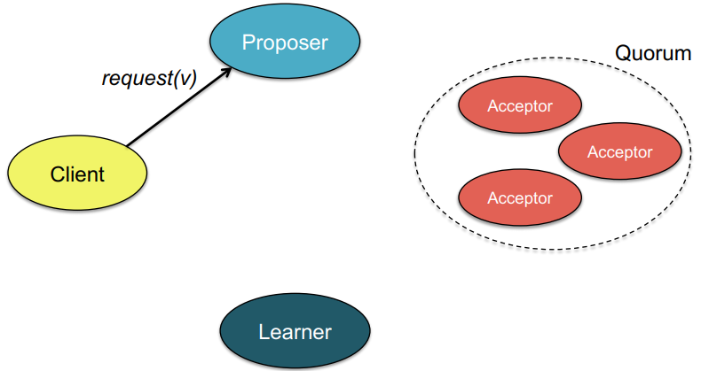
Action of Paxos
At the beginning:
Client/Node sends a request(v) to the proposer;

Slide 9
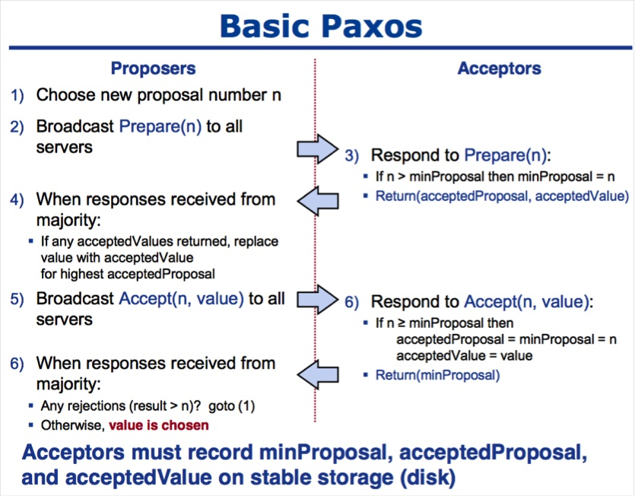
Outline
Introduce the basic Paxos steps → use it in a complete process of achieving consensus.

Slide 10
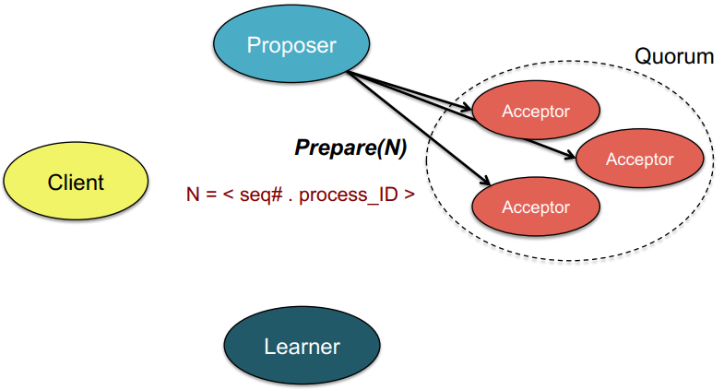
Basic Paxos
Proposer creates a proposal index N for the request, where N is the larger than any previous proposal index used by this proposer. → N is unique and incremental.
Proposer sends a Prepare(N) request to quorum of acceptors (however many you can reach, but a majority).

Slide 11
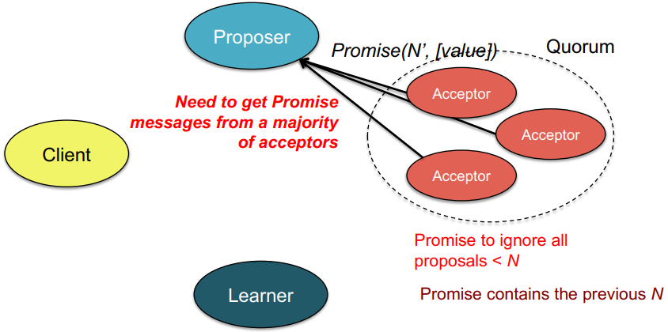
Basic Paxos
Acceptor promises that:
No longer accept Prepare(N’) request if N’<=N;
No longer accept Propose(N’,v) request if N’<N;
and return Promise(acceptedProposal, acceptedValue) → latest accepted proposal and its index;
Scudo code:
If (minProposal == null), then return Promise(null, null);
If (minProposal > N), then no return;
If (minProposal < N), then return (acceptedProposal, acceptedValue);

Slide 12
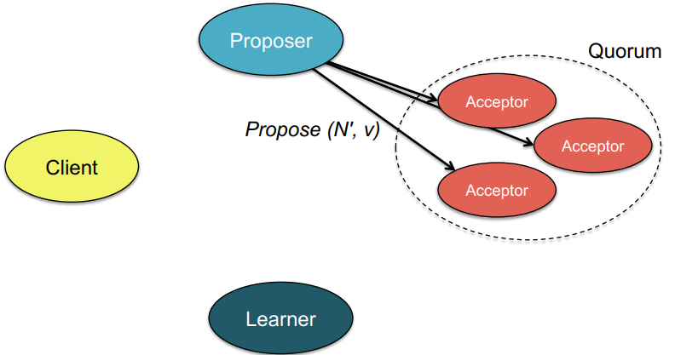
Basic Paxos
Propose (N, v)
If Proposer receives promises from a majority of the acceptors:
If all acceptedValue == Null, then v = v;
Else v = acceptedValue of the largest acceptedProposal (i.e. the value of the largest the index);
Send Propose(N, v) to acceptors;
Else send Prepare(v) request again;

Slide 13
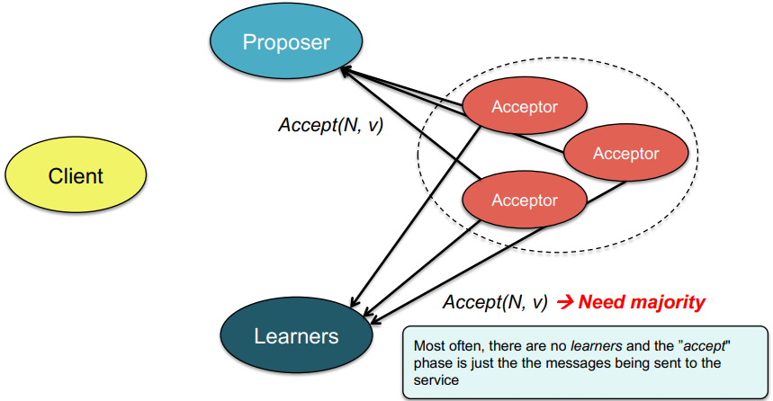
Basic Paxos
For each acceptor: If N >= minProposal then
acceptedProposal = minProposal =N;
acceptedValue = v;
return Accept(N,v);
Else no response

Slide 14
Basic Paxos
If a majority of the acceptors send out Accept(N,v);
Broadcast the result to all learners.
Else send Prepare(v) request again

Slide 15
How basic Poxas achieves consensus?
Assume we want to choose a master from following servers:
server1
server2
server3

Slide 16
Prepare
Each server sends Request(“I want to be a master.”) to proposers. The order of the received Request is proposer2 → proposer1 → proposer3 with No.1, No.2, No.3 respectively.
Proposers send Prepare to majority of the acceptors: Assume acceptor1 and acceptor2 first receive proposer1’s message:
server1
server2
server3
Request(“I want to be a master.”)
Request(“I want to be a master.”)
Request(“I want to be a master.”)
proposer1
proposer2
proposer3
Prepare(No.2)
Prepare(No.2)
acceptor1
acceptor2
acceptor3
Notes:
Animations here

Slide 17
Prepare
Assume acceptor1 and acceptor2 first receive proposer1’s message:
Return Promise(null, null) to proposer1 since they haven’t received any request before.
server1
server2
server2
proposer1
proposer2
proposer3
Promise(null, null)
Promise(null, null)
acceptor1
acceptor2
acceptor3
Notes:
Animations here

Slide 18
Prepare
Then proposer2’s message arrived at acceptor2 and acceptor3:
server1
server2
server2
proposer1
proposer2
proposer3
Promise(null, null)
Promise(null, null)
Prepare(No.1)
Prepare(No.1)
acceptor1
acceptor2
acceptor3
Notes:
Animations here

Slide 19
Prepare
Then proposer2’s message arrived at acceptor2 and acceptor3:
Acceptor3 returns Promise(null, null) to proposer2 since it hasn’t received any request before.
Acceptor3 will not return since it has already promised proposer1
server1
server2
server2
proposer1
proposer2
proposer3
Promise(null, null)
Promise(null, null)
Promise(null, null)
acceptor1
acceptor2
acceptor3
Notes:
Animations here

Slide 20
Prepare
Finally, proposer3’s message arrived at acceptor2 and acceptor3:
server1
server2
server2
proposer1
proposer2
proposer3
Promise(null, null)
Promise(null, null)
Promise(null, null)
Prepare(No.3)
Prepare(No.3)
acceptor1
acceptor2
acceptor3
Notes:
Animations here

Slide 21
Prepare
Finally proposer3’s message arrived at acceptor2 and acceptor3:
Acceptor2 returns Promise(null, null) to proposer3 since No.3> No.2.
Acceptor3 returns Promise(null, null) to proposer3 since it hasn’t received any request before.
Proposer2 sends Prepare(No.4) to acceptor2 and acceptor3 and receives Promise(null, null) from accepter2 and acceptor3.
server1
server2
server2
proposer1
proposer2
proposer3
Promise(null, null)
Promise(null, null)
Promise(null, null)
Promise(null, null)
Promise(null, null)
acceptor1
acceptor2
acceptor3
Notes:
Animations here

Slide 22
Prepare
Proposer2 send Prepare(No.4) to acceptor2 and acceptor3 and receive Promise(null, null) from accepter2 and acceptor3.
server1
server2
server2
proposer1
proposer2
proposer3
Promise(null, null)
Prepare(No.4)
Prepare(No.4)
Promise(null, null)
Promise(null, null)
Promise(null, null)
acceptor1
acceptor2
acceptor3
Notes:
Animations here

Slide 23
Prepare
Proposer2 send Prepare(No.4) to acceptor2 and acceptor3 and receive Promise(null, null) from accepter2 and acceptor3.
server1
server2
server2
proposer1
proposer2
proposer3
Promise(null, null)
Promise(null, null)
Promise(null, null)
Promise(null, null)
Promise(null, null)
Promise(null, null)
acceptor1
acceptor2
acceptor3
Notes:
Animations here

Slide 24
Accept
Proposer1 send Propose(No.2, server1) to acceptor1 and acceptor2; same to proposer2 and proposer3;
Acceptor1 accepts Propose(No.2, server1)
Acceptor2 accepts Propose(No.4, server2)
(acceptedProposal=No.4, acceptedValue = server2);
Acceptor3 accepts Propose(No.4, server2),
(acceptedProposal=No.4, acceptedValue = server2);
server1
server2
server2
proposer1
proposer2
proposer3
Propose(No.2, server1)
Propose(No.4, server2)
Propose(No.3, server3)
acceptor1
acceptor2
acceptor3
Notes:
Animations here

Slide 25
Accept
Majority of the acceptors accept (No.4, server2) → learner always hears about acceptance events from the nodes doing the accepting → commit to a value “server2” (i.e., execute the request and send a response to the client)
server1
server2
server2
Request(“I want to be a master.”)
proposer1
proposer2
proposer3
Propose(No.2, server1)
Propose(No.4, server2)
Propose(No.3, server3)
acceptor1
acceptor2
acceptor3
(server2)
learner
Notes:
Animations here

Slide 26
reference
https://www.cs.rutgers.edu/~pxk/417/notes/content/10-paxos-slides.pdf
https://blog.the-pans.com/paxos-explained/
https://courses.engr.illinois.edu/cs525/sp2013/L9_paxos.sp13.ppt
www.cs.berkeley.edu/~istoica/classes/cs294/11/notes/07-gene-paxos.pptx
https://zhuanlan.zhihu.com/p/75373655
https://zhuanlan.zhihu.com/p/23811020
https://zhuanlan.zhihu.com/p/31780743
https://blog.the-pans.com/paxos-explained/

Slide 27
Questions?

